Slide 1


A PRESENTATION ON “Sleep Resistant Alert System” FOR FINAL YEAR PROJECT(8th SEMESTER)
Submitted By:
Team: Mind Benders
Project ID:PIET/2016-20/CS/PRJ25
Project Guide: Mr. Deepak Moud

Slide 2
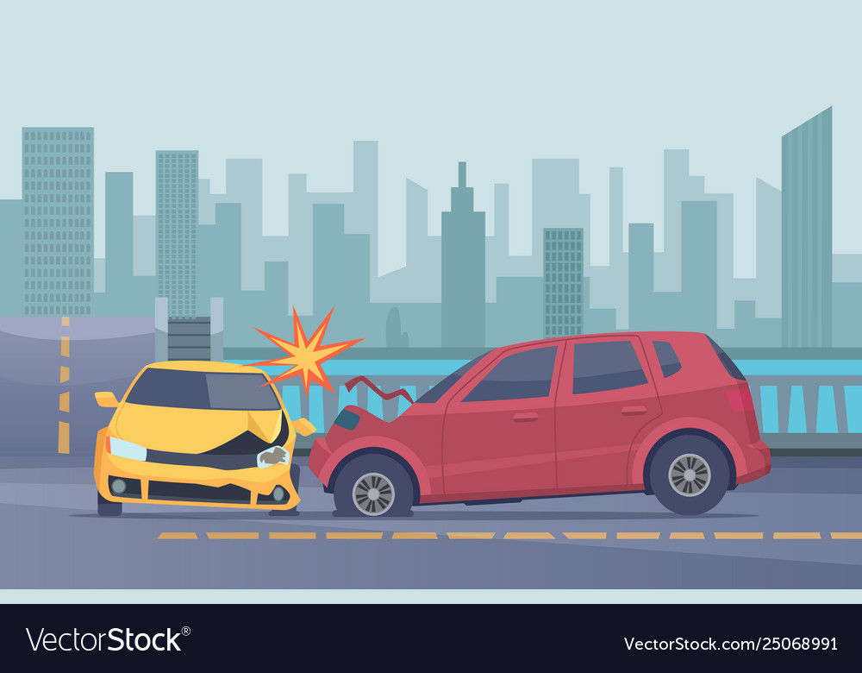






INTRODUCTION
The project is designed to reduce the number of accidents caused due to drowsy driving. The system will be focusing on the facial region of driver, eliminating background faces, if any. In the facial region both the eyes will be constantly monitored in order to detect the state of eye, in case the system detects closing of eyes for longer duration then it will play the alarm to awaken the driver. This system will help driver to regain sense and would indirectly warn to either take a break or to focus more while driving. The project work does not ensure prevention of accident but is a step to improve the security of driver if he/she is not in accurate state of driving.

Slide 3
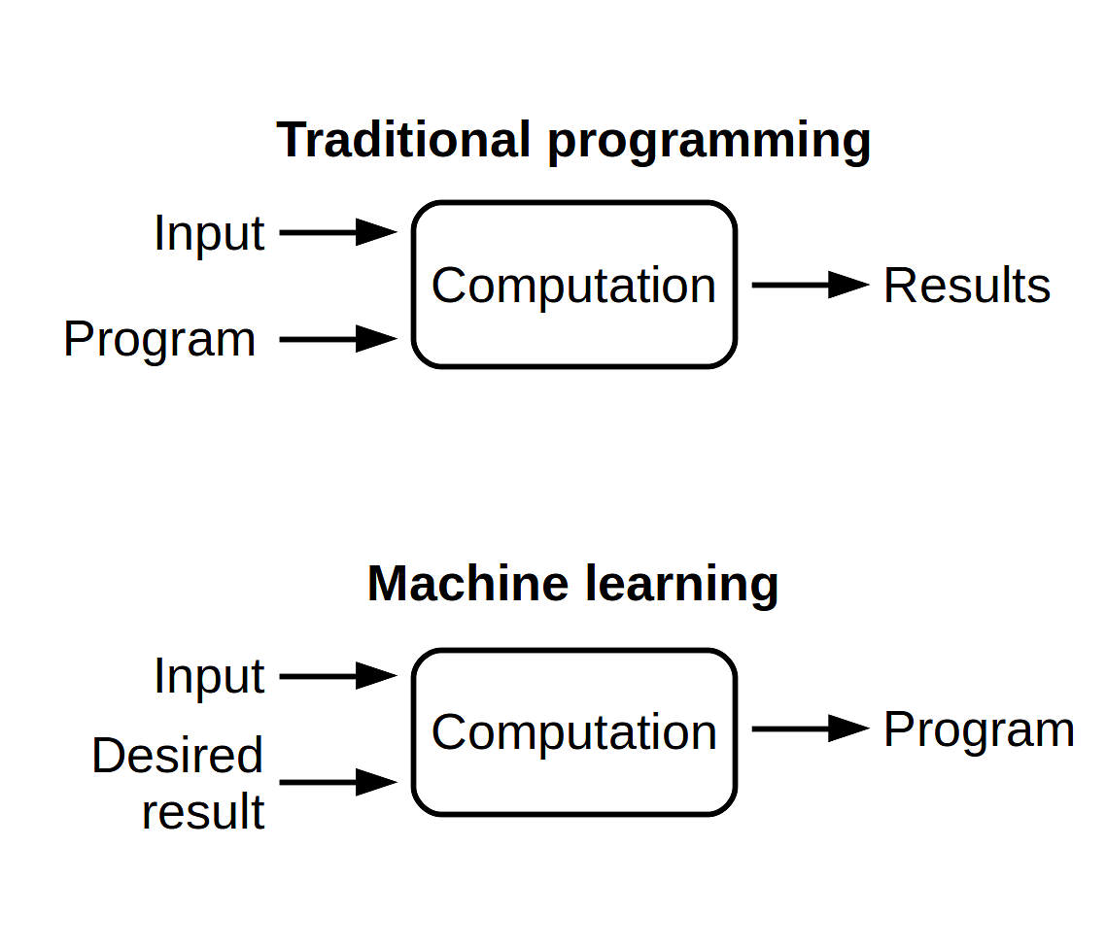


Technology Used: Machine Learning
Traditional Programming
Machine Learning
Machine Learning is the field of study that gives computers the capability to learn without being explicitly programmed. As it is evident from the name, is gives the computer ability that makes it more similar to humans: The ability to learn.

Slide 4




What is image recognition?
Image recognition uses artificial intelligence technology to automatically identify objects, people, places and actions in images. Image recognition is used to perform tasks like labeling images with descriptive tags, searching for content in images, and guiding robots, autonomous vehicles, and driver assistance systems.
Image recognition is natural for humans and animals but is an extremely difficult task for computers to perform.
The most effective tool found for the task for image recognition is a deep neural network, specifically a Convolutional Neural Network (CNN). CNN is an architecture designed to efficiently process, correlate and understand the large amount of data in high-resolution images.

Slide 5
Convolutional Neural Network
In a Convolutional Neural Network (CNN) the neurons in one layer don’t connect to all the neurons in the next layer. a convolutional neural network uses a three-dimensional structure, where each set of neurons analyzes a specific region or “feature” of the image. CNNs filters connections by proximity (pixels are only analyzed in relation to pixels nearby), making the training process computationally achievable. In a CNN each group of neurons focuses on one part of the image.

Slide 6

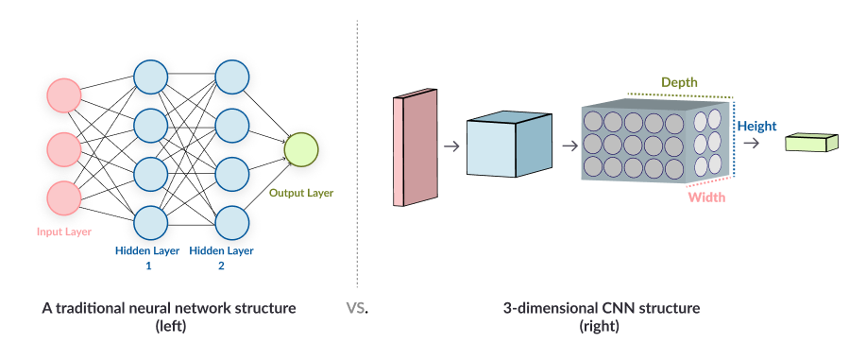
Traditional vs. Convolutional

Slide 7


PREREQUISITE
Object Detection
Face Recognition
Eye Recognition

Slide 8
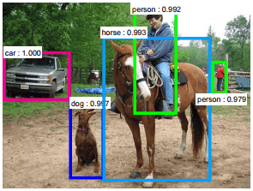
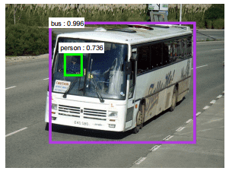
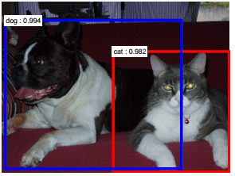
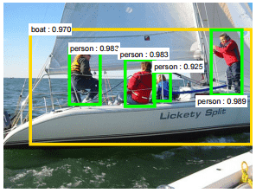
Object Detection
Object detection is commonly defined as method for discovering and identifying the existence of objects of a certain class. Also it can be considered as a method in image processing to find out an object from images. There are several ways to classify and find objects in a frame. Out of that one way can be based on color identification. But it is not an efficient method to detect the object as several different size object of same color may be present. Hence a more efficient way is Haar-like features, developed by Viola and Jones on the basis of the proposal by Papageorgiou et. al in 1998.

Slide 9




Face Recognition
We know that face is also a type of object. So we can consider detection of face as a particular case of object detection. In this type of object type of class detection, we try to know where the objects in the interest image are located and what is their size which may belongs to a particular class. The work of algorithm that is made for face detection is mostly concentrated on finding the front side of the face.

Slide 10




Eye Recognition
Poor contrast of eyes generally creates a lots of problems in its detection. After successful detection of face eye needs to be detected for further processing. In our method eye is the decision parameter for finding the state of driver. Though detection of eye does not look complex but the actual process is quite hectic. In this case it performs the detection of eye in the specified region.

Slide 11


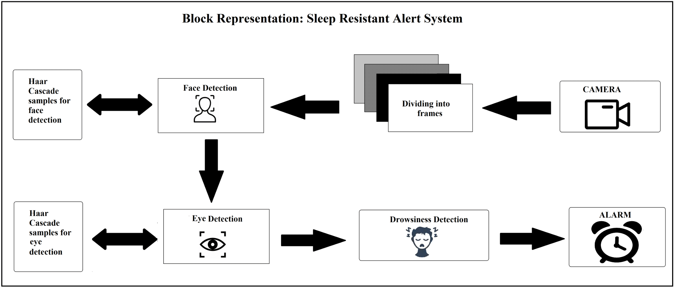
Project Work Flow

Slide 12

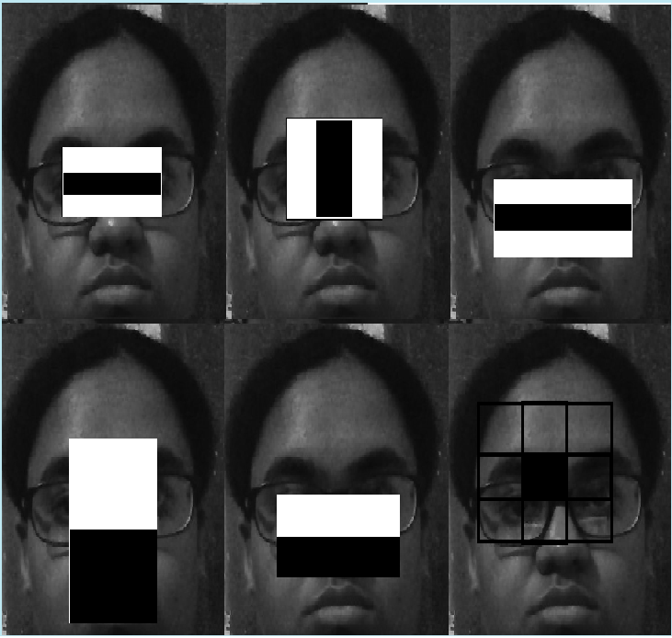
In the initial state we require dataset to train the model, this can be done using haar cascade’s face and eye detection datasets
Sample Dataset
DATASET
CREATION
Detect Face
Detect Eyes
Score Limit

Slide 13
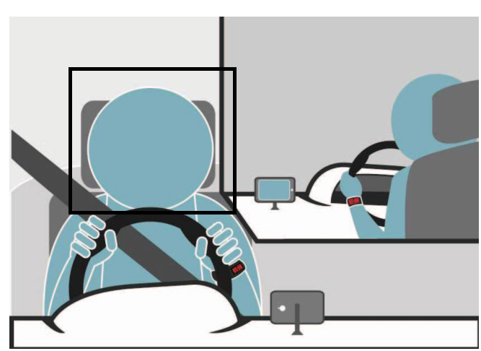
Then we can easily detect driver’s face and highlight the “Region of Interest”
Face Detect
Dataset Creation
DETECT
FACE
Detect Eyes
Score Limit

Slide 14

In this step we focus on eye region and analyze its moments followed by settlement of score to each frame
Open
Eye Detect
Blink
Closed
Dataset Creation
Detect Face
DETECT
EYE
Score Limit

Slide 15
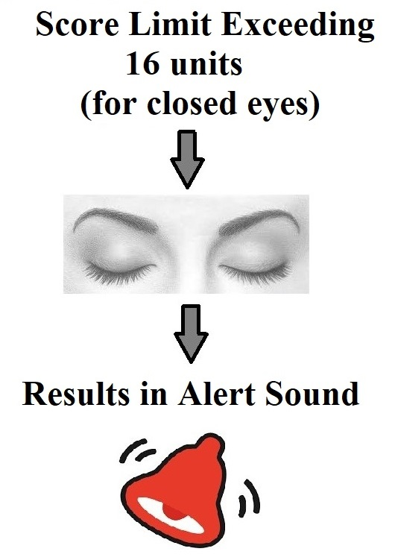
Counter is set to differentiate eye moments and for closed eyes if counter value exceeds 16 units results in alert sound
Score Limit
Dataset Creation
Detect Face
Detect Eyes
SCORE LIMIT

Slide 16
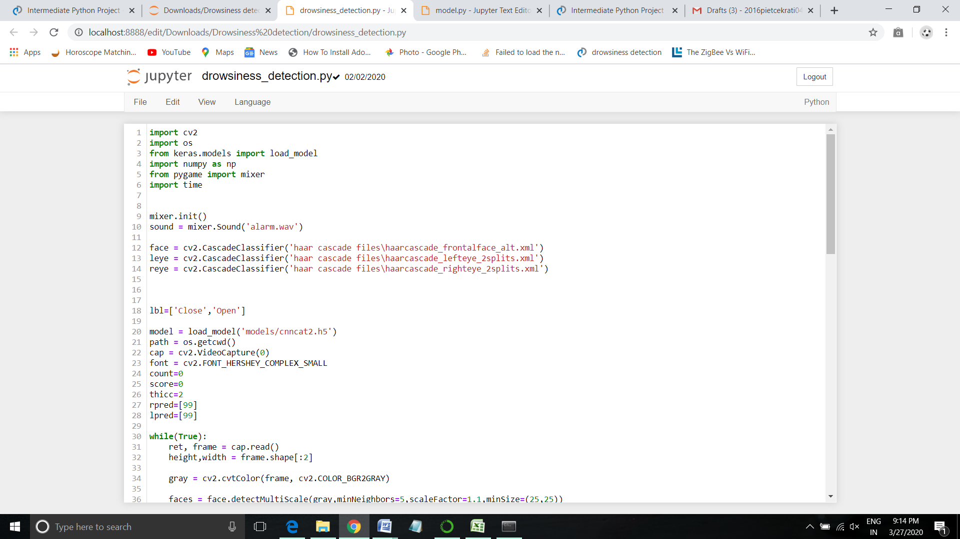
Snapshots
Code Fragment: 1

Slide 17
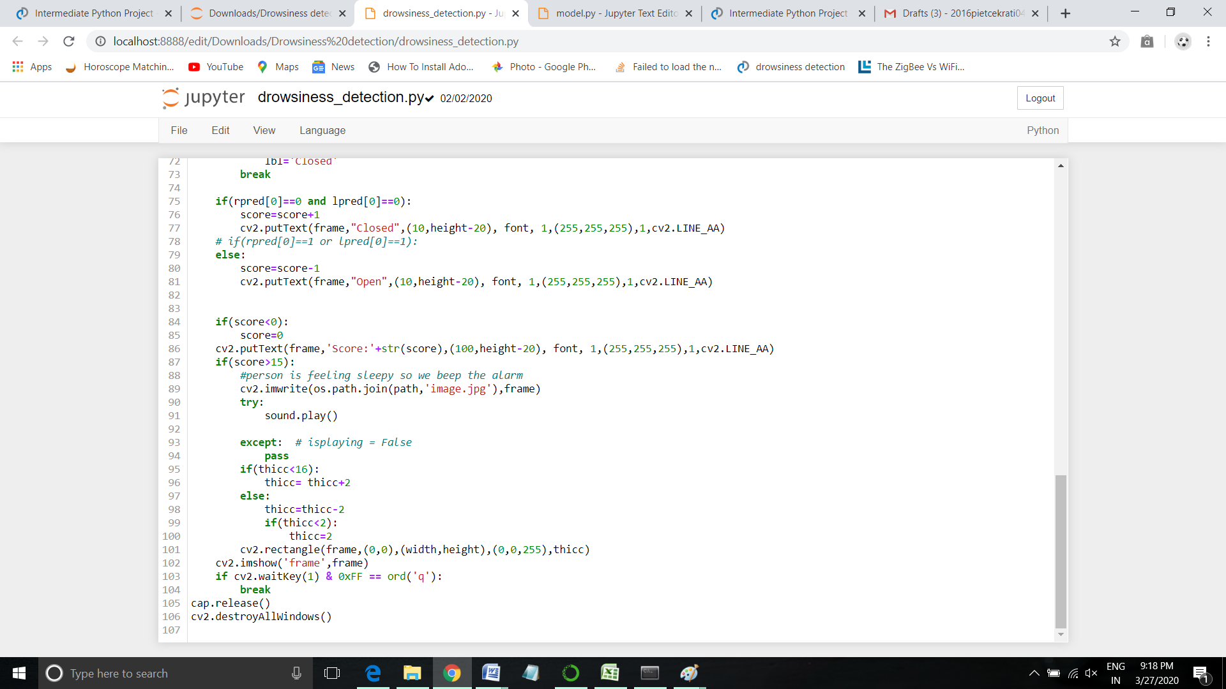
Code Fragment: 2

Slide 18
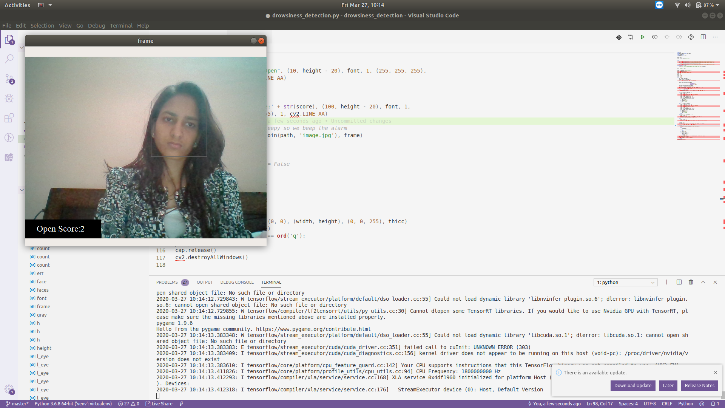
Output 1: Open Eyes Detection

Slide 19
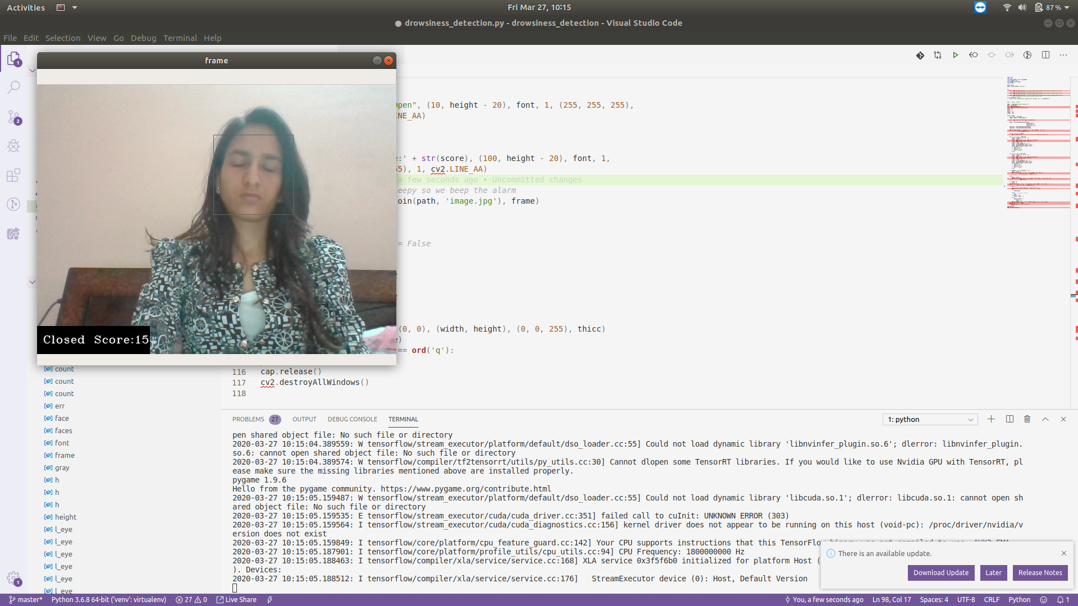
Output 2: Closed Eyes Detection

Slide 20
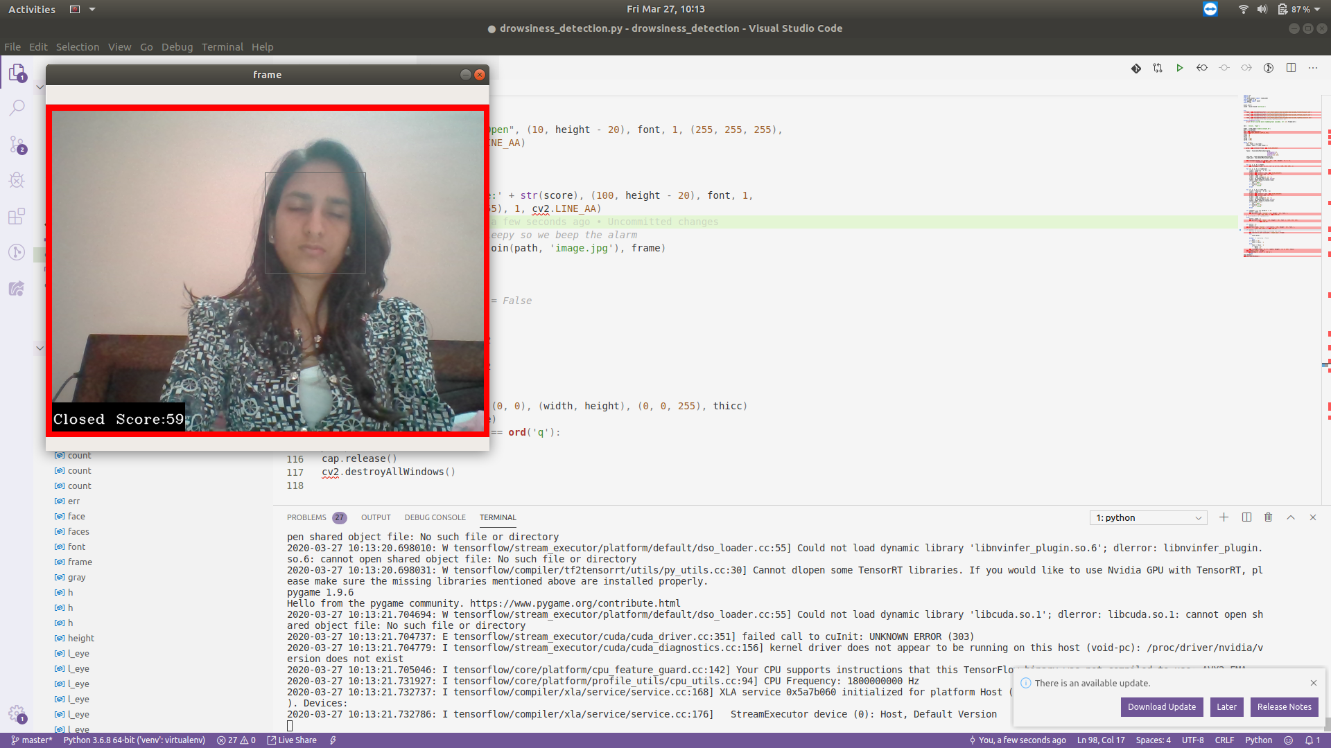
Output 3: Drowsy Detection

Slide 21


Slide 22
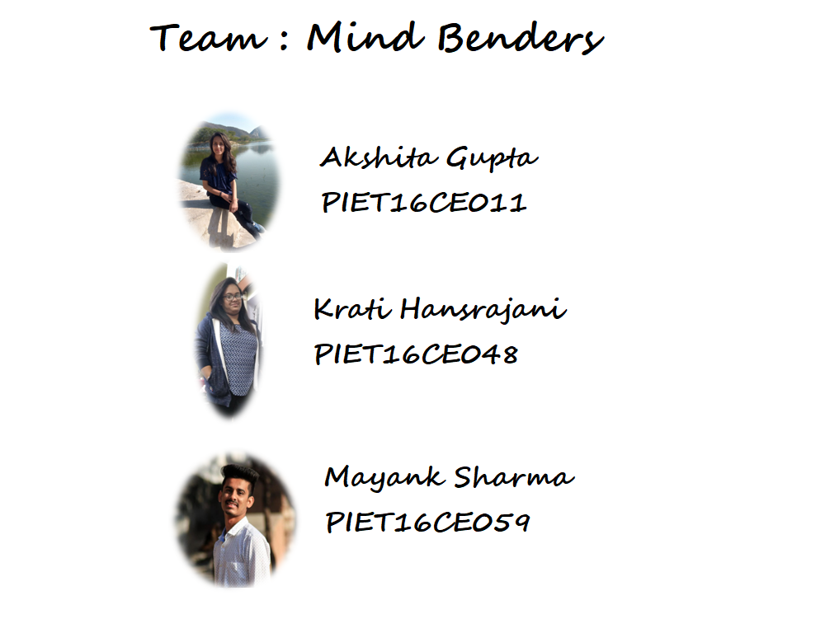

Team : Mind Benders

